Slide 1
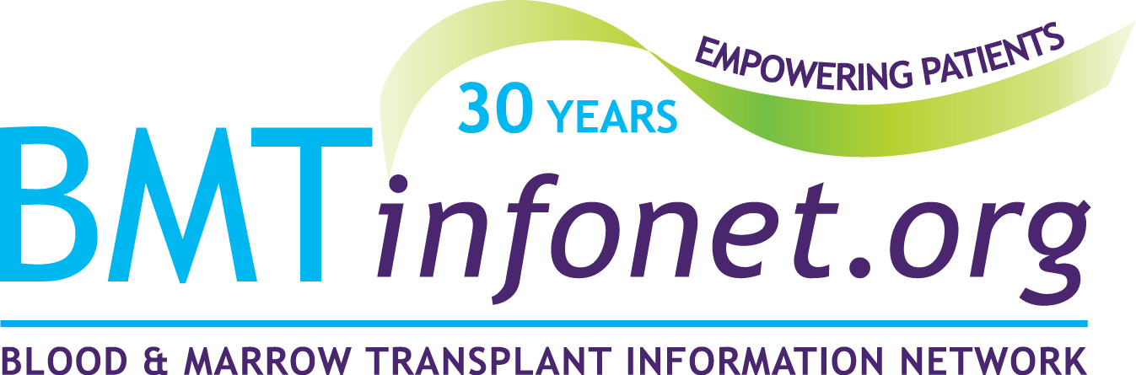

Transplantation for Myelodysplastic Syndromes:
Who, When and How?
Hosted by
Blood & Marrow Transplant Information Network (BMT InfoNet)
Wednesday, October 27, 2021
Hilary Jacobs, transplanted in 2009
for Myelodysplastic Syndrome

Slide 2
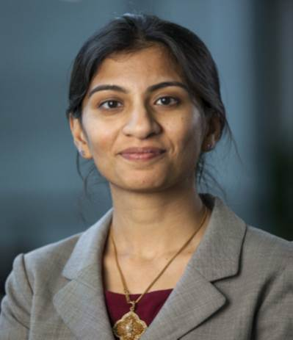
Meet The Speaker
Nandita Khera, MD, MPH, Co-Chair of the Blood and Marrow Transplant Clinical Trials Network Evidence into Practice Task Force
Dr. Khera is an Associate Professor of Medicine in the Mayo Clinic College of Medicine, and a Consultant in the Division of Hematology/Oncology at Mayo Clinic Arizona since 2011. Dr. Khera treats patients with hematological malignancies, especially those needing a blood stem cell or bone marrow transplant for their disease.

Slide 3

Transplantation for Myelodysplastic Syndromes: Who, When and How?
Nandita Khera MD MPH
On behalf of the CIBMTR and as Co-chair, BMT CTN Task Force on Evidence into Practice
Associate Professor, Mayo Clinic, Phoenix, AZ

Slide 4
Disclosures
None

Slide 5
Outline
Myelodysplastic syndromes (MDS)
Role of allogeneic hematopoietic cell transplant for MDS
-Introduction to the transplant process
-Describe results of the observational study and recent clinical trial
-List potential challenges for patient and providers to get to transplant

Slide 6
What is MDS and how common is it?
Group of bone marrow stem cell cancers
  Defined by low blood counts, marrow dysplasia (abnormal looking cells) and chromosome changes/ genetic mutations
  Need for transfusions and risk of infections due to low white blood cell count
  Range from low severity/ indolent disease to very high severity based on risk of transformation to full blown leukemia
Uncommon before the age of 50 years; mostly diagnosed in people in their 70s
Number of patients living with MDS in USA is estimated to be between 60,000 and 170,000

Slide 7
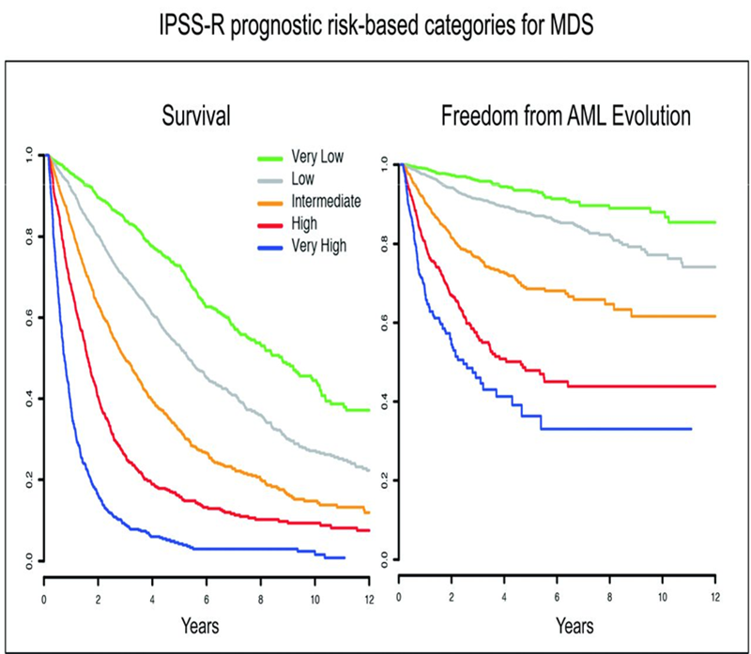
What are the risk categories for MDS?
Risk is determined by:
  which blood counts are low and how low
  number of blasts (abnormal cells in the marrow)
  type of chromosome changes
Emerging data for role of genetic mutations
Response to treatment
Greenberg PL et al. Blood 2012
Della Porta M. Leukemia 2015

Slide 8
How do we treat MDS?
Supportive care:
  transfusions, growth factors, minimal medical interventions
Disease Modifying treatments:
  treatments that may change the natural history of the MDS but don’t cure” it
Curative therapy:
  HCT-hematopoietic cell transplantation (aka bone marrow or stem cell transplant)

Slide 9
How do we decide which treatment approach is best?
Treatment for MDS
Patient age/ fitness
MDS risk category
Risk of treatment
Patient goals/ wishes

Slide 10
Allogeneic Transplantation for MDS
Potentially curative therapy

Slide 11
What is allogeneic hematopoietic cell transplantation (HCT)?
A procedure in which bone marrow that is diseased or damaged is replaced with stem cells from another donor
Rationale: New (transplanted) immune system attacks cancer cells that survived chemotherapy/radiation (called the graft-versus-tumor effect)

Slide 12
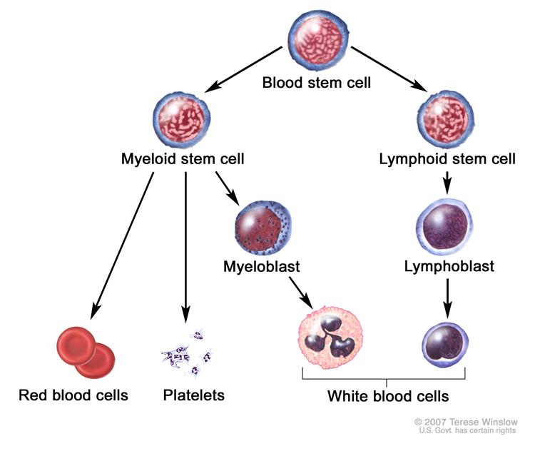
What are stem cells?
Stem cells:
  develop into mature white blood cells, red blood cells, or platelets
  found in
    bone marrow, especially in the pelvis, femur, and sternum
    umbilical cord blood
    in small numbers, in blood

Slide 13
What are the risks and benefits of a transplant?
High risk of complications from transplant
  -infections
  -GVHD
  -organ toxicity
Frailty/ poor functional status
Donor availability
Insurance coverage
High risk MDS
Poor risk genetic mutations
No response to non-transplant treatments
Potential cure

Slide 14
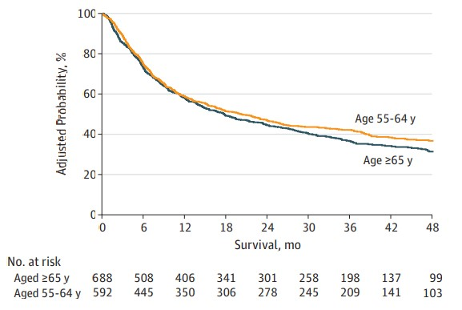
Medicare Coverage With Evidence Development Program
Overall survival by age
Study to see how well older patients with Medicare do with a transplant compared with younger patients
Compared outcomes of patients 55-64 years vs ≥ 65 years
Enrollment Dec 2010 to May 2014
Similar survival between younger and older patients
Notes:
n 2010, the US Centers for Medicare & Medicaid Services (CMS) indicated that data regarding efficacy of allogeneic hematopoietic stem cell transplantation (HCT) in the CMS beneficiary population with myelodysplastic syndrome (MDS) were currently insufficient, but that coverage would be provided for patients enrolled in a clinical study that met its criteria for Coverage with Evidence Development (CED)
RESULTS During the study period, 688 patients aged 65 years or older underwent HCT for MDS and were compared with 592 patients aged 55 to 64 years. Other than age, there were no differences in patient and disease characteristics between the groups. On univariate analysis, the 3-year NRM rate was 28% vs 25% for the 65 years or older group vs those aged 55 to 64 years, respectively. The 3-year OS was 37% vs 42% for the 65 years or older group vs the 55 to 64 years age group, respectively. On multivariable analysis after adjusting for excess risk of mortality in the older group, age group had no significant association with OS (HR, 1.09; 95% CI, 0.94-1.27; P = .23) or NRM (HR, 1.19; 95% CI, 0.93-1.52; P = .16). CONCLUSIONS AND RELEVANCE Older patients with MDS undergoing HCT have similar OS compared with younger patients. Based on current data, we would recommend coverage of HCT for MDS by the CMS.

Slide 15
To transplant or not……

Slide 16
BMT CTN 1102 Study Design:
Multicenter, biologic assignment study
Enrollment
Matched related or unrelated donor search for up to 90 days
Donor arm: transplant using lower intensity regimen within 6 months
No Donor arm: hypomethylating agent or best supportive care
Inclusion criteria
high risk MDS
50-75 years
Any prior therapy
No prior unrelated donor search
Eligible for reduced intensity alloHCT from a matched related or unrelated donor
Primary endpoint:
Lived for 3 years
Secondary endpoints:
Lived for 3 years without leukemia
Quality of life (QoL)
Cost effectiveness

Slide 17
Clinical outcomes
(Donor arm=260 and No donor arm=124 patients)
Patients who lived for 3 years
Patients who lived for 3 years without leukemia

Slide 18
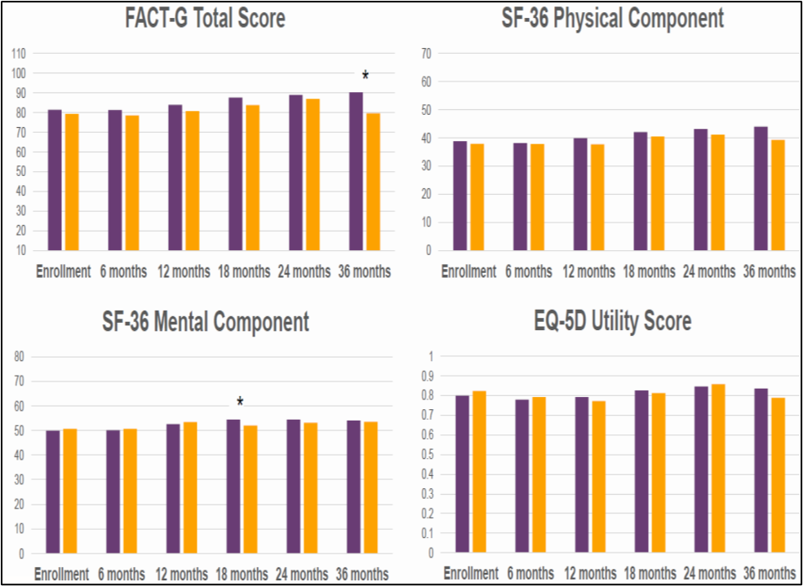
Quality of life similar in both groups

Slide 19
Study conclusions
Among patients with higher-risk MDS, aged 50-75, having a suitable matched related or unrelated donor leads to improved outcomes
  HCT should be considered as an integral part of MDS management plans for these patients
  Early referral to a transplant center is recommended

Slide 20
What does it mean for me as a patient with MDS?
Your transplant team works with your treating doctor on a care plan and searches for a donor
Best possible donor is chosen and dates for transplant are decided
You meet with a transplant doctor/ team
Referral from your treating doctor
You undergo a comprehensive clinical evaluation

Slide 21






HLA Today: A new program from
Be The Match
Have kits available for newly diagnosed patients
Request family member HLA typing (if desired)
Refer appropriate patients to transplant center for HCT consultation
Community Hem/Onc doctors order free cheek swab kits from NMDP/Be The Match
Swab patient at diagnosis and send in for
HLA typing
Receive unrelated donor match report from NMDP/Be The Match
in 7-10 days*
*Family member results will be sent separately.
Notes:
You place an order for free buccal swab kits from our team at the National Marrow Donor Program (NMDP)/Be The Match.
We deliver the kits to your hematology/oncology practice so you have them available for newly diagnosed patients.
You swab your patient’s cheek at the time of diagnosis and send the kit to the NMDP/Be The Match for high-resolution HLA typing. Typing is performed at the same laboratory that performs HLA typing for our NMDP/Be the Match donors (LabCorp).
You can also request free HLA typing for family members.
In seven to 10 days, we send you an email with your patient’s HLA typing results, search prognosis and a preliminary unrelated donor and cord blood unit search report. The family member HLA report will arrive separately. A physician from the NMDP/Be The Match is available to discuss the results.
You refer appropriate patients to a transplant center for HCT consultation. We encourage you to consult with a transplant center no matter the search report prognosis. There are options for patients other than HCT using fully matched related or unrelated donors or cord blood units. The transplant center can assist with exploring these options for your patient.
Family typing results will be sent separately

Slide 22
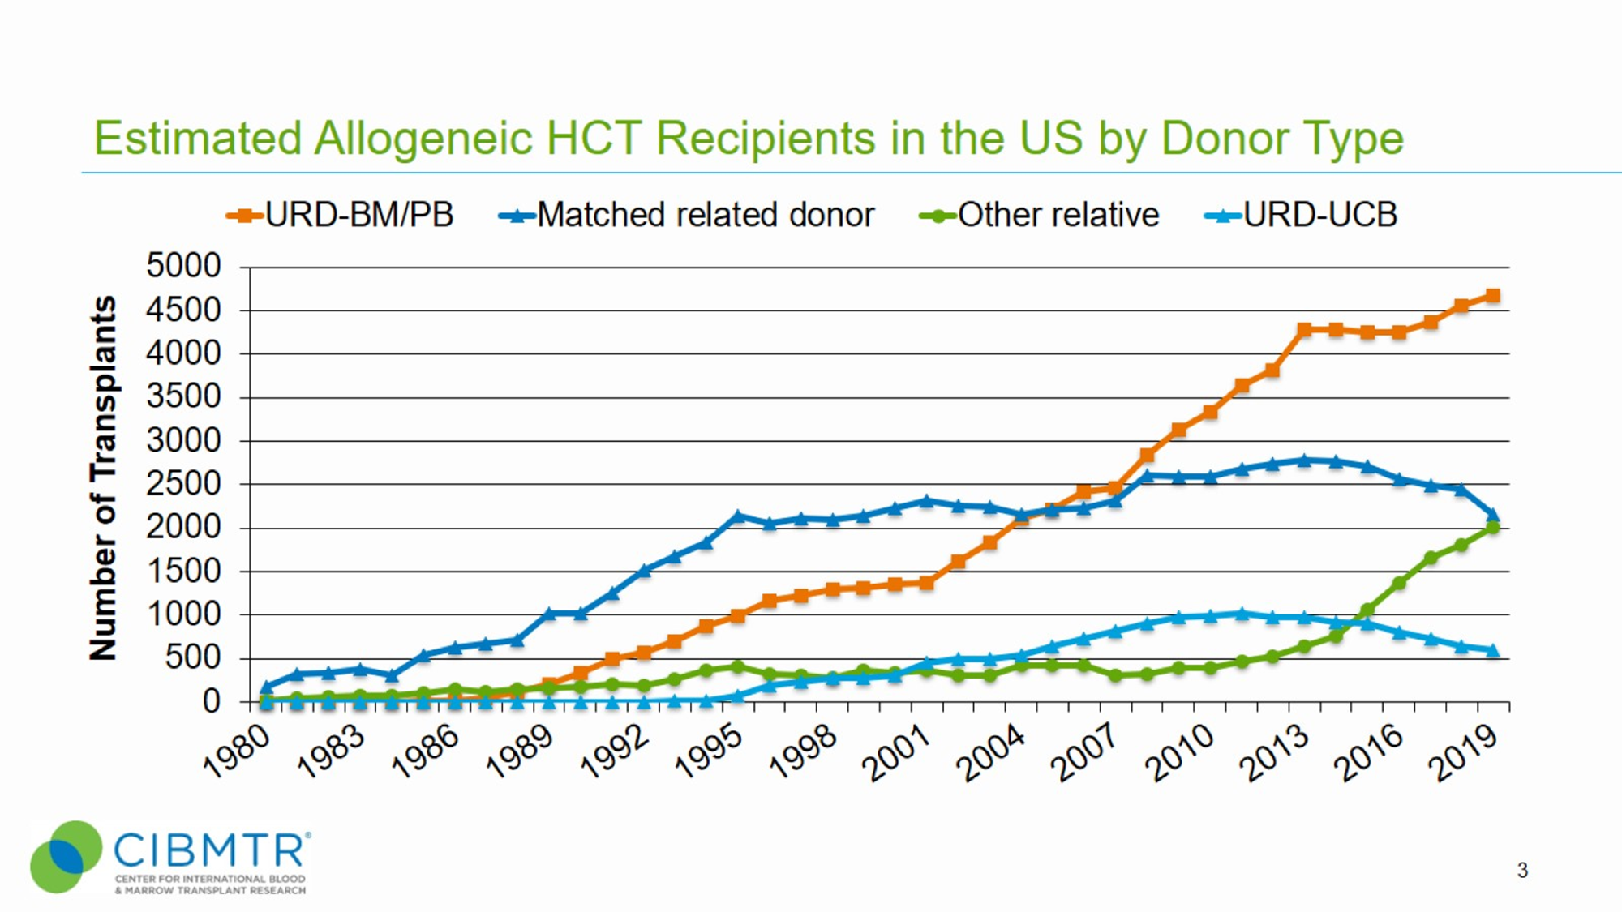
Who will be my donor?
A matched sibling is the preferred donor
Lack of a donor is no longer a major limitation to transplants
Most everyone who needs a transplant will have a suitable donor

Slide 23
What is the process of allogeneic transplant
Your new cells start to grow
Early recovery and discharge from the hospital
You undergo conditioning followed by stem cell infusion
You are admitted to the hospital
You are followed closely in the outpatient clinic for the first 100 days after transplant

Slide 24
Potential complications of allogeneic transplant
Acute and chronic GVHD (40 to 60% risk)
Veno-occlusive disease (3 to 4% risk)
Bacterial/ viral and fungal infections (10 to 60% risk)
Late effects such as cardiac complications (5 to 20%) and second cancers (2 to 6%)
20 30 40 50 60 70 80 90 100 150 180 1 year 5 years
Time Post Transplant

Slide 25
Graft versus host disease (GVHD)
Occurs because of differences between the cells of your body and the donor cells
Severity ranges from mild to life-threatening
Two types:
  Acute:
    Develops in the first 100 days after transplant but can occur later
    usually involves skin rash, nausea/diarrhea or liver issues
  Chronic GVHD:
    Usually develops 3-6 months after transplant, but can appear earlier or later
    Can involve most organ systems like skin, eyes, lungs, joints etc
    Adversely impacts long term quality of life

Slide 26
Impact of late effects on morbidity
Adverse impact of chronic GVHD on quality of life, health and functional status
Survivors with late effects/ chronic health conditions
  lower physical functioning
  lower likelihood of full-time work or study
  higher likelihood of limitations in usual activity
  higher incidence of distress
Pidala J. Blood 2011
Khera N. JCO 2012
Sun et al. Blood 2011

Slide 27
What determines the success of transplants?
In general, transplants are most successful if:
  MDS is in remission at the time of transplant and has not transformed to leukemia
  Good organ function
  Optimum functional status
  No major uncontrolled infections
  Good psychosocial support

Slide 28
How to prepare for transplant and improve chances of a successful outcome
Get information about risks and benefits of transplant
Explore non-transplant options such as clinical trials
Select a transplant center
  Live within about an hour of transplant center for at least 100 days after allogeneic HCT
Continue to optimize your functional status and nutrition
Select/decide about caregiver plan
Plan your finances

Slide 29
What can I do as a potential transplant caregiver?
3 main areas of support:
  Medical –gather information, talk to doctors and help care for the patient
  Financial –talk to the insurance company and help manage transplant costs and daily household finances
  Emotional and social –listen and support the patient
Taking care of yourself while caring for your loved one
  Many resources available for supporting caregivers

Slide 30
Potential challenges for transplant as treatment plan
Patient perceived
  Perceptions about high risks of transplantation
  Social barriers
  Need for transportation and lodging benefits
  Lack of caregiver
  Lack of insurance/ undocumented patients
  Lack of optimal donors
Provider perceived
  Lack of awareness of the process of transplant among community hematologists/ oncologists
  Potential revenue loss
  Lack of care coordination
  Financial barriers to HCT/need for in-network insurance
  Lack of clarity on post-transplant care

Slide 31
What can we do as hematology/ oncology providers?
Educate patients about all treatment options
Improve access to allogeneic transplant for all eligible patients
Partner with referring oncologists to ensure early referral of all newly diagnosed patients for transplant consultation
Develop strategies to help with prehabilitation and social support for our older patients with MDS
Improve both non transplant and transplant treatment approaches to get best clinical outcomes

Slide 32
To conclude: Allogeneic HCT for MDS
Who
  Patients with high risk MDS who are medically eligible
When
  Referral to transplant center as early as possible in the disease course
  Consider transplant when disease under best possible control and otherwise ‘fit’ as determined by transplant team
How
  Complicated multi step process involving multiple stakeholders with need for a prolonged followup

Slide 33
Acknowledgements
NMDP/Be The Match
CIBMTR and BMT CTN leadership
BMT CTN Evidence into Practice Task Force (especially Dr Linda Burns: my co-chair)

Slide 34
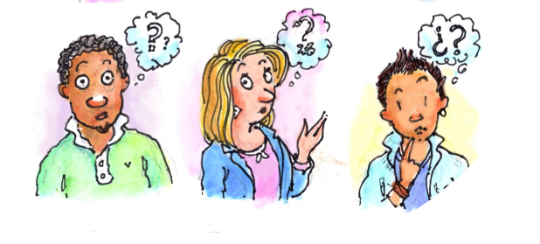
Questions?
Dr. Nandita Khera
.
bmtinfonet.org ✦ help@bmtinfonet.org ✦ 847-433-3313

Slide 35
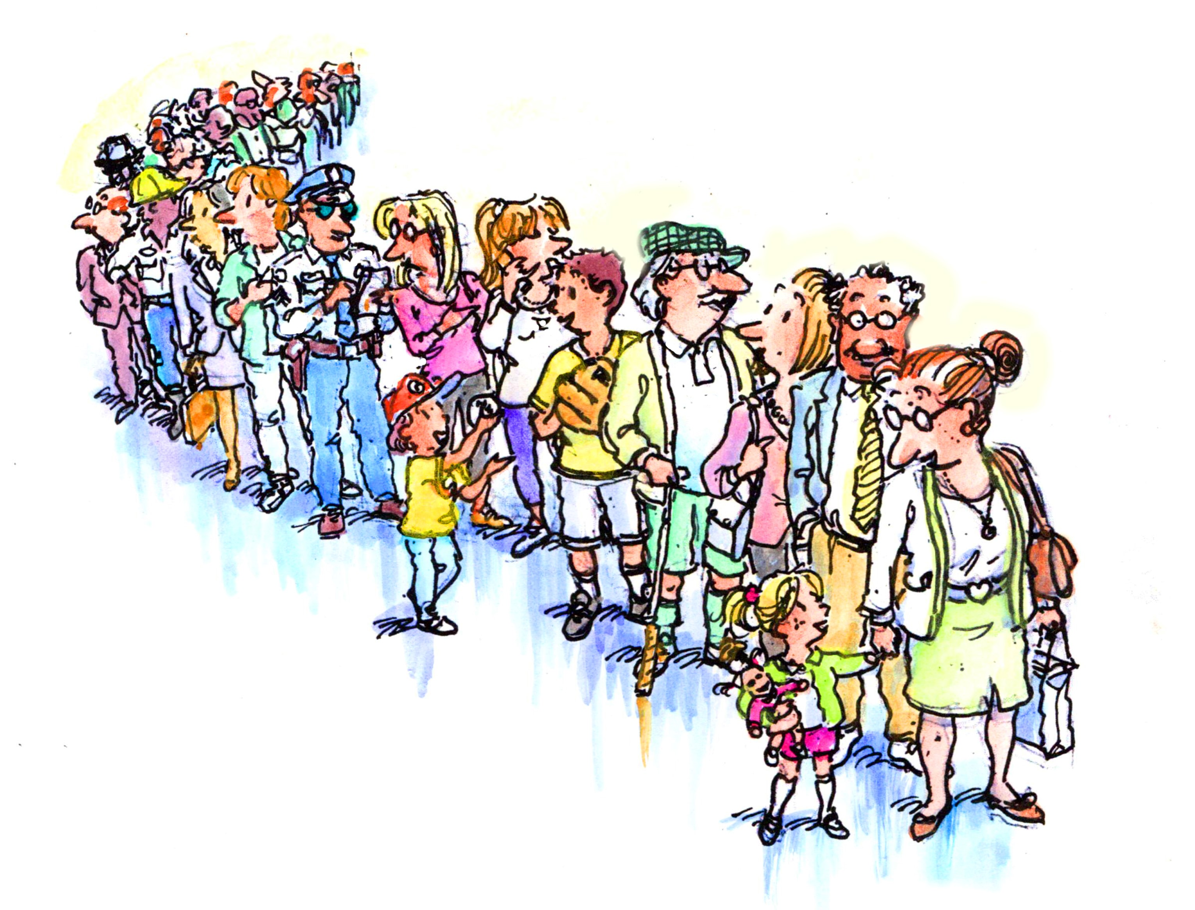
Let Us Know How BMT InfoNet Can Help YOU!
Visit our website: bmtinfonet.org
Email us: help@bmtinfonet.org
Give us call: 888-597-7674
We’re here to help every step of the way!

