Slide 1
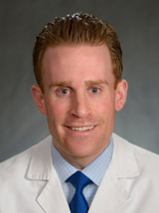

Transplant or CAR T-cell Therapy:
How to Make the Choice
Daniel J. Landsburg, MD
Associate Professor of Clinical Medicine
Hospital of the University of Pennsylvania
2023 Webinar: Transplant and CAR T-cell Therapy

Slide 2
Learning Objectives
At the end of this workshop participants will understand:
The criteria used to determine whether a stem cell transplant or CAR T-cell therapy is the best treatment option for a patient with lymphoma
Steps involved in preparing for, undergoing and recovering from a stem cell transplant compared to CAR T-cell therapy
Potential short and long-term side effects of a stem cell transplant compared to CAR T-cell therapy
2023 Webinar: Transplant and CAR T-cell Therapy

Slide 3
Learning Objectives (continued)
Likelihood of a cure and quality of life following a stem cell transplant compared to CAR T-cell therapy
Treatment options if a patient does not achieve or remain in remission following a stem cell transplant or CAR T-cell therapy
2023 Webinar: Transplant and CAR T-cell Therapy

Slide 4
Introduction to Cellular Therapy/Treatment Criteria
2023 Webinar: Transplant and CAR T-cell Therapy

Slide 5
Definitions
Autologous stem cell transplant (ASCT): reinfusion of previously-collected stem cells from the patient in order to aid in recovery of blood cell production after treatment with high dose chemotherapy
Chimeric antigen receptor-modified T cells (CART): T cells collected from the patient that are genetically modified to express a marker on the surface which is directed at a specific target on lymphoma cells (most commonly CD19)
Allogeneic hematopoietic cell transplant (alloHCT): infusion of donor stem cells to induce graft vs tumor effect and aid in recovery of blood cell production following treatment with chemotherapy (not discussed)
2023 Webinar: Transplant and CAR T-cell Therapy

Slide 6
Lymphoma subtypes treated with ASCT or CART19
Diffuse large B cell lymphoma (DLBCL)/high grade B cell lymphoma (HGBL)
  Aggressive B cell lymphoma, curable with chemotherapy, relapses are often fatal unless treated effectively
Follicular lymphoma (FL)
  Indolent B cell lymphoma, not curable with chemotherapy, many patients will survive multiple relapses
Mantle cell lymphoma (MCL)
  Technically indolent B cell lymphoma but behaves aggressively, not curable with chemotherapy, relapses are often fatal unless treated effectively
2023 Webinar: Transplant and CAR T-cell Therapy

Slide 7
Indications for ASCT vs CART19 by subtype
Disease | Line of therapy
DLBCL/HGBL | ASCT – 2nd line following response to salvage immunochemotherapy CART19 – 2nd line if relapse <1 year after completion of 1st therapy (Yescarta, Breyanzi) or unfit for ASCT (Breyanzi); ≥3rd line (Yescarta, Kymriah, Breyanzi)
FL | ASCT – relapsed disease responding to immunochemotherapy CART19 - ≥3rd line (Yescarta, Kymriah)
MCL | ASCT – 1st line following response to initial immunochemotherapy CART19 ≥2nd line (Tecartus)
2023 Webinar: Transplant and CAR T-cell Therapy

Slide 8
Practical considerations for ASCT vs CART19
FDA indication by lymphoma subtype (more specific for CART19 than ASCT)
Patient age (>75 years favor CART19)
Significant organ dysfunction (favor CART19)
Prior/current detection of lymphoma in the bone marrow (favor CART19)
Inability to collect stem cells (favor CART19)
Autoimmune disease/solid organ transplant (favor ASCT)
Poor social support/concerns about compliance (favor ASCT)
2023 Webinar: Transplant and CAR T-cell Therapy

Slide 9
Clinical dilemmas recommending ASCT vs CART19 – disease specific
Diffuse large B cell lymphoma (DLBCL)/high grade B cell lymphoma (HGBL)
  Older patient with relapse >1 year after completion of initial therapy
  Patient with partial response to 2nd line salvage immunochemotherapy
Follicular lymphoma (FL)
  Very sick patient who responds well to salvage immunochemotherapy (rare)
Mantle cell lymphoma (MCL)
  Younger patient with less aggressive disease at diagnosis
2023 Webinar: Transplant and CAR T-cell Therapy

Slide 10
ASCT and CART19 Process and Side Effects
2023 Webinar: Transplant and CAR T-cell Therapy

Slide 11
Pre-ASCT/CART19 – Pre-Treatment Testing
Lab testing for exposure to viruses (specifically hepatitis B/C and HIV)
Heart function evaluation
Lung function evaluation
Other testing (rare)
  Dental clearance
  Age-appropriate cancer screening (eg colonoscopy, mammogram)
Abnormal testing results may prompt referral to a specialist
2023 Webinar: Transplant and CAR T-cell Therapy

Slide 12
ASCT/CART19 – Team Members
Provider team (MDs and APPs)
  Care may be transferred from a lymphoma team to a cell therapy team
  Inpatient provider team will provide care if/when hospitalized
Cell therapy nurses
  Coordinate may logistics and support patients during the pre-ASCT/CART19 process
Social workers
Financial team
2023 Webinar: Transplant and CAR T-cell Therapy

Slide 13
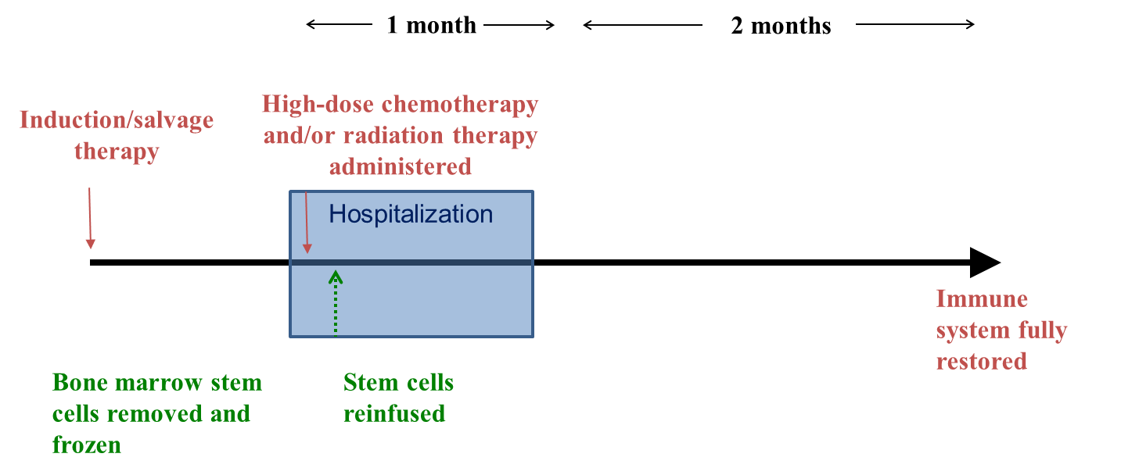
ASCT – Process
2023 Webinar: Transplant and CAR T-cell Therapy

Slide 14
ASCT – Stem Cell Collection
Taken from the blood through a process called apheresis (filtration circuit)
  Rarely through aspiration from the bone marrow
Will need to have an apheresis catheter placed
Ways to “mobilize” stem cells from the bone marrow to the blood
  Upon natural bone marrow recovery from recent chemotherapy + GCSF (~2 weeks prior)
  Mozobil/GCSF injections starting a few days prior
Typically 1-3 days of apheresis needed to collect adequate stem cells
2023 Webinar: Transplant and CAR T-cell Therapy

Slide 15
ASCT – Hospitalization – Initial Days
Receive high dose chemotherapy during the first 5-6 days
  May experience GI symptoms during that time
Receive stem cell reinfusion one day after completion of chemo
  Performed at bedside
  Stem cells are thawed in a hot water bath and reinfused through a central line
  Providers, nurses and stem cell lab staff present during the procedure
  Odor from stem cell preservative may permeate for a few days
2023 Webinar: Transplant and CAR T-cell Therapy

Slide 16
ASCT – Hospitalization – Side Effects
GI side effects (nausea/vomiting/diarrhea/mucositis)
  May require IV fluids or IV anti-nausea medications
  May benefit from several days of total parenteral nutrition (TPN)
Fevers
  Not always due to infection, but typically antibiotics are given
Low blood counts
  Almost all patients need transfusions of red blood cells and platelets
Significant fatigue
2023 Webinar: Transplant and CAR T-cell Therapy

Slide 17
ASCT – Hospitalization – Discharge
Blood counts start to increase
  No longer neutropenic
  No longer requiring regular red cell or platelet transfusions
GI symptoms improve
  No longer requiring IV medications or TPN
Energy level improves
  No longer needing significant assistance from nurses or medical assistants
2023 Webinar: Transplant and CAR T-cell Therapy

Slide 18
ASCT – Recovery at Home
Typical recovery periods is 2-3 months
May feel more fatigued after returning home
  More activity required when living at home as compared to a hospital room
Can return to regular activities as tolerated
  Check with your provider team about precautions when in public
Will have periodic lab work and office visits during first 3 months post-ASCT
PET-CT or CT scans performed ~day 100 after ASCT
2023 Webinar: Transplant and CAR T-cell Therapy

Slide 19
ASCT – Long-Term Side Effects
Mildly decreased blood counts (common)
Infertility (may have already occurred)
Decreased natural antibody production (hypogammaglobinemia)
  Can treat with intravenous immune globulin (IVIg)
Organ damage (rare)
Severely decreased blood counts (rare)
Development of secondary cancer (rare)
2023 Webinar: Transplant and CAR T-cell Therapy

Slide 20
Process – CART19
Cytotherapy, 2017; 19: 1015–1024
2023 Webinar: Transplant and CAR T-cell Therapy

Slide 21
CART19 – T-cell Collection
Taken from the blood through a process called apheresis (filtration circuit)
May or may not need to have an apheresis catheter placed
  Some patients may collect with two peripheral IVs
No need for mobilization
  T cells are naturally present in the blood
Typically 1 day of apheresis needed to collect adequate T cells
2023 Webinar: Transplant and CAR T-cell Therapy

Slide 22
CART19 – Infusion
May be done inpatient or outpatient
  Depends on CART19 product, patient characteristics, disease status, etc…
Receive lymphodepleting chemotherapy a few days prior
  Purpose is to prime immune system to receive CART19
Monitoring post-infusion may be done inpatient or outpatient
  Inpatient – typically ~7-10 day hospital stay
  Outpatient – at least weekly office visits/lab work
2023 Webinar: Transplant and CAR T-cell Therapy

Slide 23
CART19 – Side Effects
Cytokine release syndrome (CRS)
  One or more of fever, low blood pressure, low oxygen level
  May not be treated if mild
  Typical treatments: Tylenol, tocilizumab
Immune effector cell-associated neurotoxicity (ICANS)
  One or more of confusion, disorientation, inattention, seizures (rare), brain swelling (rare)
  Always treated when present
  Typical treatment: dexamethasone
2023 Webinar: Transplant and CAR T-cell Therapy

Slide 24
CART19 – Recovery
Typically minimal recovery time if side effects are not severe
Must “live” within 2 hours of medical center for 30 days after infusion
  Patients living far away will require temporary housing
Must be living with a caregiver for 30 days after infusion
May not drive for 60 days after infusion
Will have periodic lab work and office visits during first 3 months
PET-CT or CT scans performed ~30-90 days after infusion
2023 Webinar: Transplant and CAR T-cell Therapy

Slide 25
CART19 – Long-Term Side Effects
Mildly decreased blood counts (common)
Decreased natural antibody production (hypogammaglobinemia)
  Can treat with intravenous immune globulin (IVIg)
Long-term susceptibility to infection
Organ damage (rare)
Severely decreased blood counts (rare)
2023 Webinar: Transplant and CAR T-cell Therapy

Slide 26
Vaccination Post-ASCT/CART
Recommendations vary by center
Infect Dis Clin North Am. 2019 June ; 33(2): 593–609
2023 Webinar: Transplant and CAR T-cell Therapy

Slide 27
Outcomes Following ASCT and CART19
2023 Webinar: Transplant and CAR T-cell Therapy

Slide 28
ASCT Outcomes – DLBCL/HGBL
~50% 5-year remission rate following ASCT whether early or late relapse for patients who respond to salvage therapy
Biol Blood Marrow Transplant. 2014 Nov;20(11):1729-36
2023 Webinar: Transplant and CAR T-cell Therapy

Slide 29
CART19 Outcomes – DLBCL/HGBL
Yescarta
30-40% 5-year remission rate following CART19 (as ≥3rd line therapy) for Yescarta or Kymriah
CTL019 (Kymriah)
Blood. 2023 May 11;141(19):2307-2315.
N Engl J Med. 2021 Feb 18;384(7):673-674.
2023 Webinar: Transplant and CAR T-cell Therapy

Slide 30
ASCT Outcomes – Follicular Lymphoma
~50% 15-year remission rate following ASCT, not necessarily receiving salvage therapy
Br J Haematol. 2023 Apr;201(2):319-325
2023 Webinar: Transplant and CAR T-cell Therapy

Slide 31
CART19 Outcomes – Follicular Lymphoma
Yescarta (blue line)
70-80% 1-year remission rate following CART19 (as ≥3rd line therapy) for Yescarta or Kymriah
Kymriah
Lancet Oncol. 2022 Jan;23(1):91-103
Nat Med. 2022 Feb;28(2):325-332.
2023 Webinar: Transplant and CAR T-cell Therapy

Slide 32
ASCT Outcomes – Mantle Cell Lymphoma
~80% 6-year remission rate following ASCT if receiving 3 years of rituximab maintenance afterwards
N Engl J Med. 2017 Sep 28;377(13):1250-1260.
2023 Webinar: Transplant and CAR T-cell Therapy

Slide 33
CART19 Outcomes – Mantle Cell Lymphoma
Tecartus
~50% 3-year remission rate following Tecartus (as ≥3rd line therapy)
J Clin Oncol. 2023 Jan 20;41(3):555-567
2023 Webinar: Transplant and CAR T-cell Therapy

Slide 34
Treatment Options Beyond ASCT or CART19
2023 Webinar: Transplant and CAR T-cell Therapy

Slide 35
Therapies after ASCT or CART19
Diffuse large B cell lymphoma (DLBCL)/high grade B cell lymphoma (HGBL)
  ASCT or CART19 (if not previously received)
  Bispecific antibodies (epcoritamab, glofitamab)
Follicular Lymphoma
  Bispecific antibodies (mosunetuzumab)
Consider clinical trials for DLBCL/HGBL, FL or MCL
2023 Webinar: Transplant and CAR T-cell Therapy

Slide 36
Bispecific Antibodies – DLBCL/HGBL
Epcoritamab
Glofitamab
~40% PFS at 12 months, with durable responses for those achieving response
J Clin Oncol. 2023 Apr 20;41(12):2238-2247.
N Engl J Med. 2022 Dec 15;387(24):2220-2231.
2023 Webinar: Transplant and CAR T-cell Therapy

Slide 37
Bispecific Antibodies – Follicular Lymphoma
Mosunetuzumab
~60% PFS at 12 months, with durable responses for those achieving response
Lancet Oncol. 2022 Aug;23(8):1055-1065.
2023 Webinar: Transplant and CAR T-cell Therapy

Slide 38
Conclusions
Both ASCT and CART19 are excellent treatment options for DLBCL/HGBL, FL and MCL
Several factors may contribute to the decision to proceed with ASCT or CART19
  FDA approval based upon type of lymphoma
  Patient factors (age, overall health, social situation)
  Disease factors (disease growth rate, response to last therapy)
Short-term toxicities are common, long-term toxicities are rare
Some but not all patients will achieve long-term remission following ASCT or CART19
Treatment recommendations should be individualized
2023 Webinar: Transplant and CAR T-cell Therapy

Slide 39
Questions?
Daniel Landsburg, MD
Perelman School of Medicine of the University of Pennsylvania
Many thanks to Kite, a Gilead Company for support of this webinar.
2023 Webinar: Transplant and CAR T-cell Therapy

Slide 40
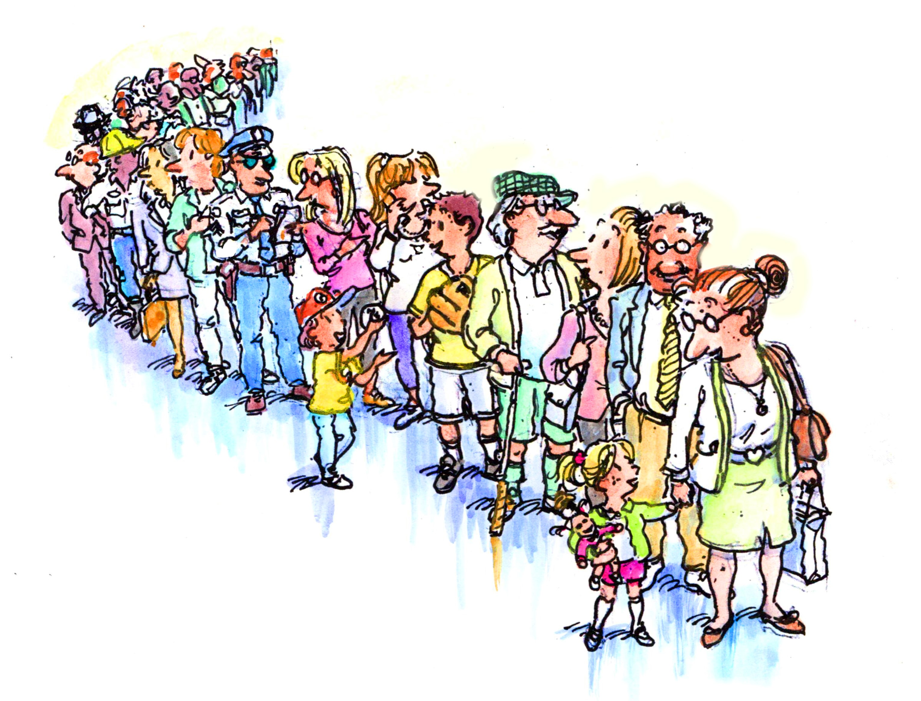
Let Us Know How BMT InfoNet Can Help You!
Visit our website: bmtinfonet.org
Email us: Help@bmtinfonet.org
Give us a call: 888-597-7674
2023 Webinar: Transplant and CAR T-cell Therapy

