Slide 1
Managing Vaginal GVHD
Hosted by
BMT InfoNet
Tuesday September 27, 2022
Lenira Maria Queiroz Mauad, MD, Gynecologist, Amaral Carvalho Hospital in the state of São Paulo, Brazil
Many thanks to Kadmon, a Sanofi company and Syndax Pharmaceuticals for support of this webinar.
bmtinfonet.org ✦ 888-597-7674 ✦ help@bmtinfonet.org

Slide 2
Managing Vaginal GVHD Lenira Maria Queiroz Mauad Amaral Carvalho Hospital Jau – SP Brazil September 27, 2022

Slide 3
How it all starts?

Slide 4
http://chemosabe-socks.blogspot.com/2013/07/graft-versus-host-disease.html?m=1

Slide 5
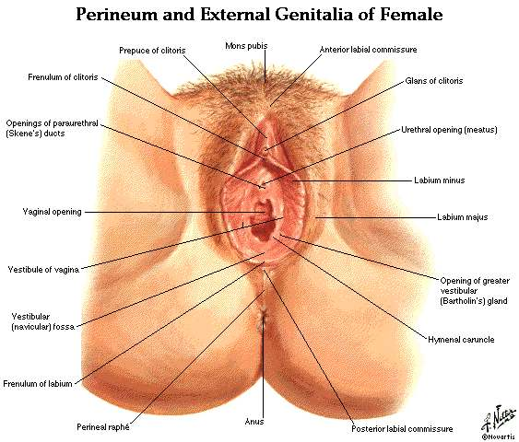
Just to understand what we are talking about..

Slide 6
In more details...

Slide 7
Vagina and cervix Internal genitalia of female

Slide 8
Why genital GVHD needs attention?
24 to 69% of HSCT recipients are affected by genital GVHD
Underestimated prevalence – many women do not report symptoms and are neither diagnosed nor treated.
Chung, 2016; Spinelli, 2003; Smith, 2014; Machado,2019.

Slide 9
When does GVHD start and when does it end ?
Median time to genital symptoms ranges from 7 to 10 months after transplant; late-onset is common.
Late-onset and late diagnosis are common especially among women who are sexually inactive and don’t have systematic genital examinations and guidance on how to prevent genital GVHD.
Sttraton, 2007

Slide 10
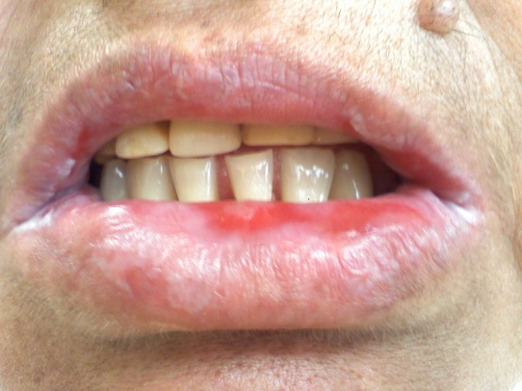
Which women are at risk?
Use of peripheral blood as source - 3 times higher than from bone marrow cells.
GVHD in oral mucosa (mouth) and/or ocular conjunctiva (eyes) involvement, as well as extensive areas of skin
Villarreal C D. An. Bras. Dermatol. 91 (3) • May-Jun 2016

Slide 11
As GVHD diminishes in other parts of the body and medication is tapered, GVHD in the genital area remains or develops, sometimes even after resolving in other organs

Slide 12
What are the signs of the early stages?
Abnormal discharge
Extreme superficial discomfort
Painful intercourse
Vulvar lesions
Biol Blood Marrow Transplant 23 (2017) 211–234

Slide 13
What happens in the vulva in early stages
Fissures
(tears)

Slide 14
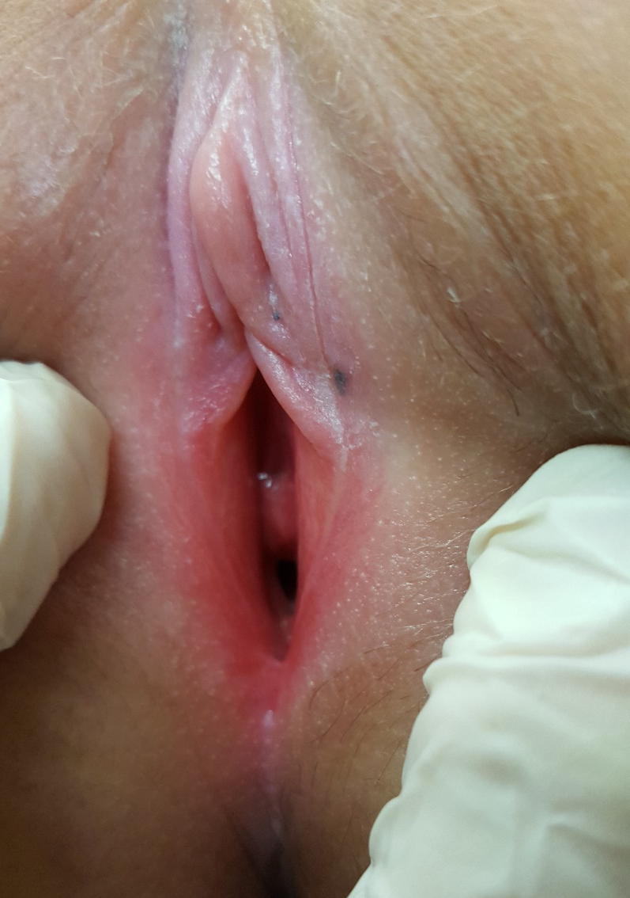
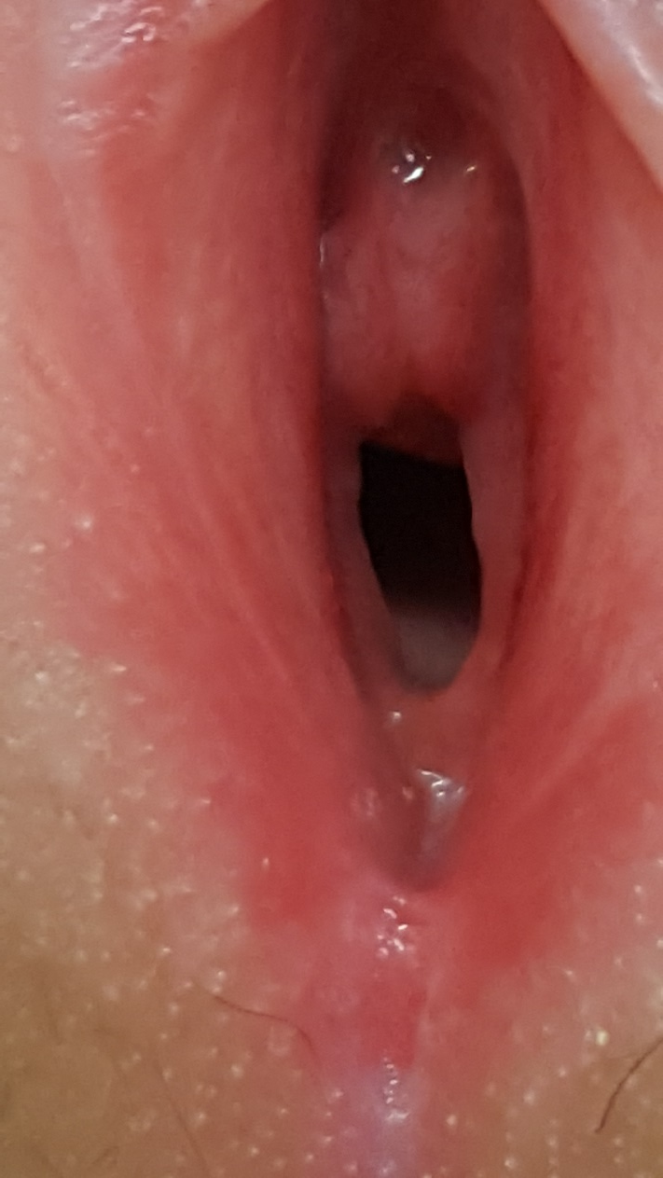
Glassy, bright
Reddish erosions

Slide 15
Ulcers

Slide 16
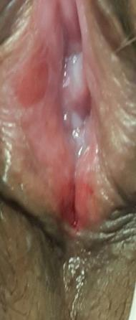
Erosions

Slide 17
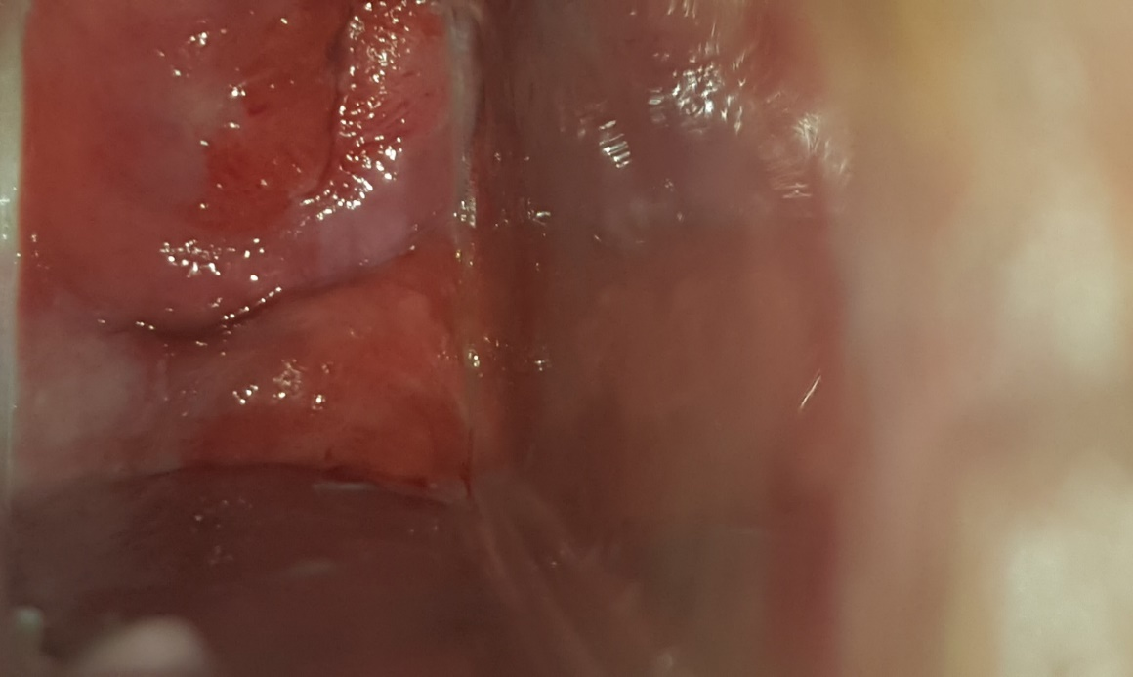
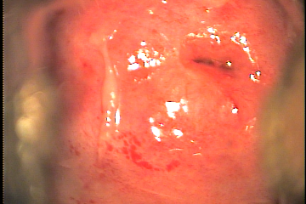
Vaginal involvement
cervix
vagina
Erosions
Abnormal discharge 25%

Slide 18
Late aspects
...there are deformities
severe vaginal adhesions causing narrowing or complete vaginal obstruction
Scarring of clitoral hood
complete disappearance or fusion of the labia
vaginal adhesions that can cause narrowing or complete closing the vagina
Biol Blood Marrow Transplant 23 (2017) 211–234

Slide 19
Without diagnosis or treatment...

Slide 20
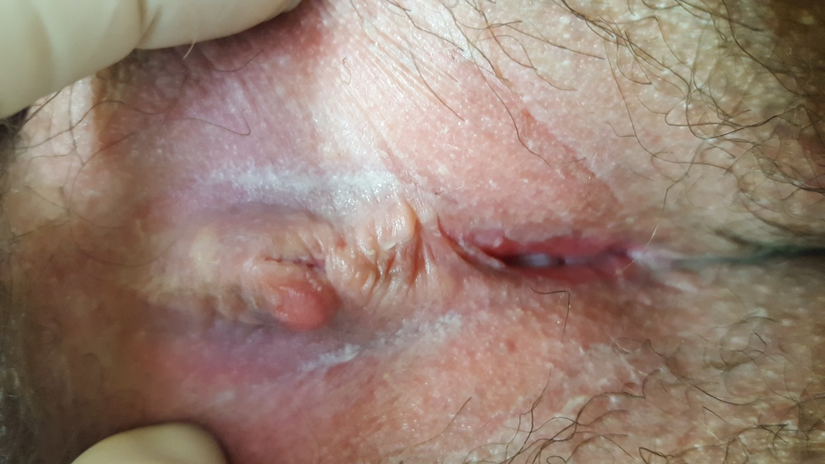
Agglutination of clitoral hood
Labial adhesions

Slide 21
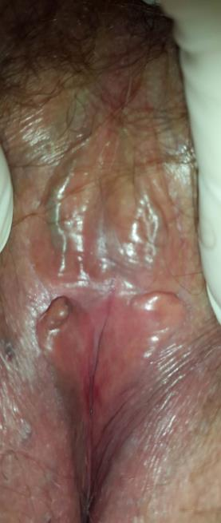
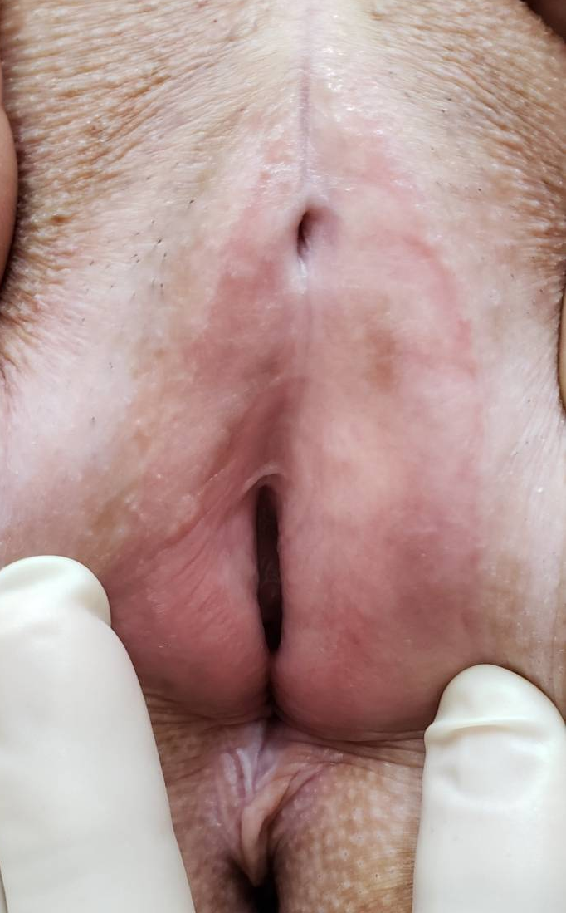
Complete disappearance or fusion of the labia

Slide 22
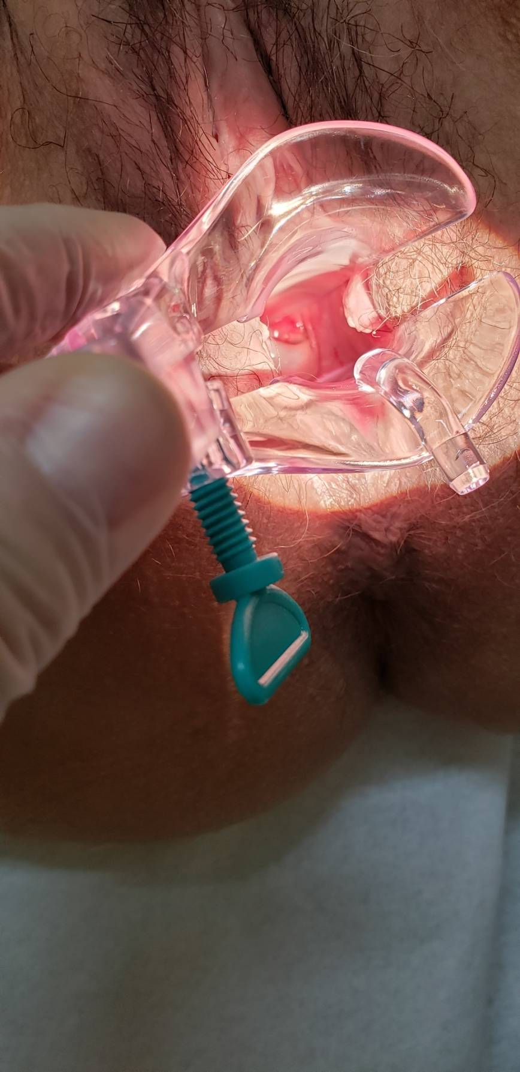
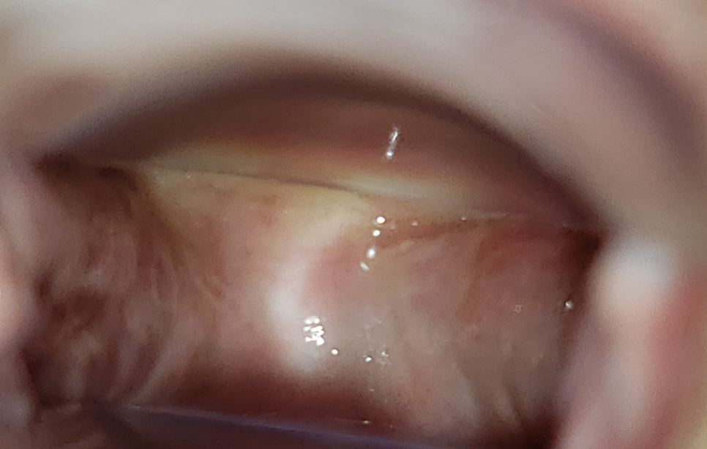
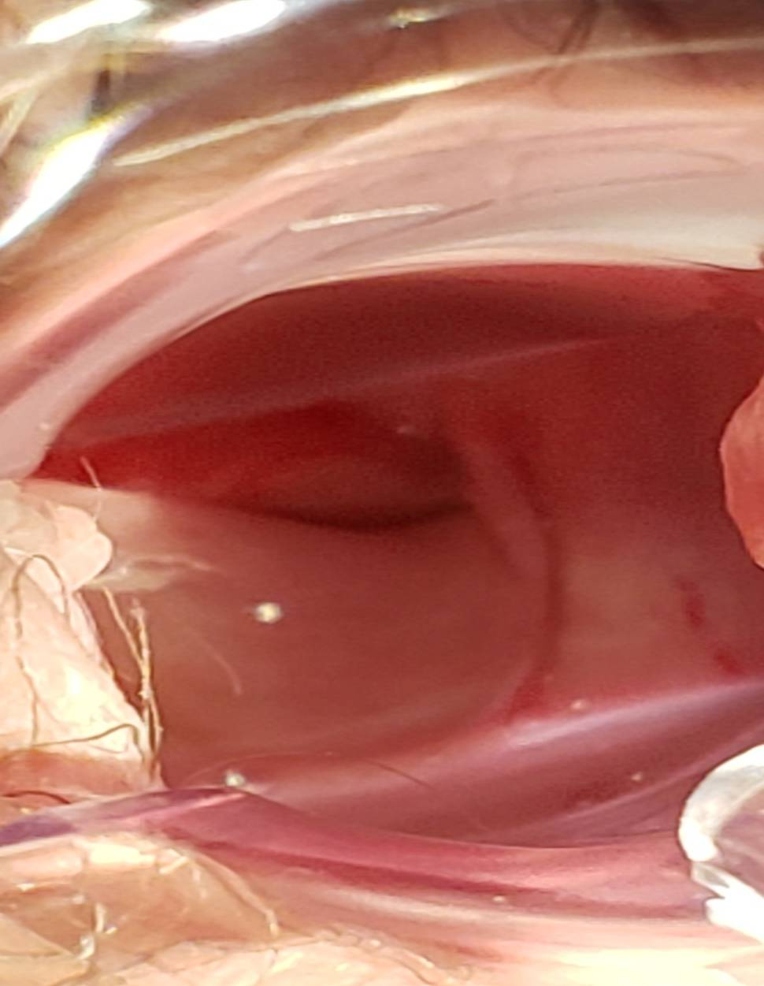
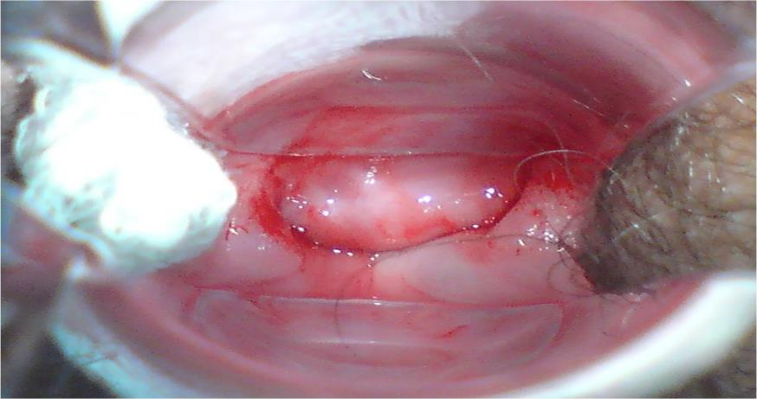
Vaginal adhesions that can cause narrowing or complete closing of the vagina
Cervix not visible
Shortened and narrowed vagina

Slide 23
How to avoid consequences?
Patients should be instructed to go to the clinic when any symptoms appear or as soon as GVHD in other organs of her body appears or worsens, especially in eyes and mouth
?

Slide 24
Which genital changes are important and need to be addressed?
Wounds
Fissures - small cuts
Reddish patches
Superficial vaginal inflammation with burning
Vaginal discharge
Bleeding or pain during intercourse

Slide 25
Other genital changes that are important and need to be addressed
Change in appearance of the vulva
Scarring or buried clitoris
Cobweb-like soft adhesions
Firm adhesions
Side-to-side firm adhesions with vaginal narrowing or obstruction

Slide 26
Your doctor will rate your GVHD grade to choose treatment
Mauad and Novais – JBMTCT 2021

Slide 27
Treatment Options:
Reduce irritation of the genital skin by using only warm water for genital hygiene.
Avoid perfumed lotions, soaps and tight underwear and clothes
Clinical guidelines for gynecologic care after HSCT B Frey Tirri et al. Bone Marrow Transplantation (2015) 50, 3–9

Slide 28
Emollients like petrolatum, glycerin, and coconut oil may be applied to the external genitalia to provide relief from irritation or itching (not inside the vagina)
Non-prescription drug management
Good skin care
Pain medication before hygiene or sexual intercourse.

Slide 29
...may mimic symptoms of genital GVHD
The changes in the vagina and vulva caused by the lack of hormones after BMT shouldn’t be forgotten.
It’s a menopause like condition and…

Slide 30
Topical estrogen in form of creams, capsules or estrogen releasing rings can be applied.
Clinical guidelines for gynecologic care after HSCT B Frey Tirri et al. Bone Marrow Transplantation (2015) 50, 3–9

Slide 31
How topical estrogen works?
Increases thickness of tissue in the vagina
Makes vaginal tissue more resilient
Clinical guidelines for gynecologic care after HSCT B Frey Tirri et al. Bone Marrow Transplantation (2015) 50, 3–9

Slide 32
Other options
Similiar to hormone therapy
Also as a lubricant

Slide 33
Pharmacological treatment should be combined with gentle and frequent vaginal dilation with manual dilators or sexual intercourse in order to prevent vaginal narrowing and scarring.
Clinical guidelines for gynecologic care after HSCT B Frey Tirri et al. Bone Marrow Transplantation (2015) 50, 3–9

Slide 34
It is best to avoid intercourse, dilation or medical action when inflammation is present.
It may make inflammation in the vagina worse.
Clinical guidelines for gynecologic care after HSCT B Frey Tirri et al.Bone Marrow Transplantation (2015) 50, 3–9

Slide 35
Preventing scarring in the vagina is important.
Vaginal scarring can interfere with routine procedures, like PAP smears, that are needed periodically to screen for cancer.
Clinical guidelines for gynecologic care after HSCT B Frey Tirri et al. Bone Marrow Transplantation (2015) 50, 3–9

Slide 36
Topical pharmacological agents that can be used in vagina or vulva
Corticosteroids – Hydrocortisone – vaginal suppository
Immunosuppressive therapy such as cyclosporine in oil base on vulva
Topical calcineurin inhibitors in vagina and/or on vulva (should be avoided if the mucous membrane in the vagina is inflamed or not intact)
Surgical management in vagina and/or vulva may be considered for severe cases not responding to treatment.
Brennan A, Hickeya M. Maturitas.105( 2017) 30-32

Slide 37
How to avoid Genital GVHD long-term consequences?
Baseline gynecological review with a specialist experienced in post-transplant gynecological care
Women should seek help as soon as they experience any symptoms of vaginal GHVD or when GVHD in other organs appears or worsens.

Slide 38
Include gynecological complaints in the routine evaluation
(with doctors and nurses)
The prevalence of genital GVHD post-transplant is unclear, which may reflect both patients’ reluctance to discuss genital symptoms and practitioners’ failure to inquire.

Slide 39
A. Lev-Sagie et al. Bone Marrow Transplantation

Slide 40
Even without symptoms, gynecological evaluation is crucial every 6 months.
If GVHD was not identified during the first 3 years after transplant, follow-up needs to be once yearly.

Slide 41
For all women undergoing transplantation
Attention should be given to the need for vaginal hormonal therapy.
Vaginal dryness due to lack of hormones gives GVHD-like symptoms and makes diagnosis difficult
Brennan A, Hickeya M. Maturitas.105( 2017) 30-32

Slide 42
Now that you know what genital GVHD looks like:
Examine yourself:
Digital self-examinations several times a week looking for pain, burning, bruising, deformities, and vaginal narrowing
…especially if you don't have sex - you may not notice the changes otherwise

Slide 43
Use of dilators or estrogen-releasing rings can help prevent recurrence of vaginal GVHD
You can order dilators or estrogen-releasing rings on the internet and receive them in the privacy of your own home.
Before using, consult your gynecologist or a physical therapist for instructions on proper use.
Clinical guidelines for gynecologic care after HSCT B Frey Tirri et al. Bone Marrow Transplantation (2015) 50, 3–9

Slide 44
If you are reluctant to do a self-examinations or dilation...
Remind yourself that you have a new lease on life, and you need to get to know your body better.
Self-exams are an important way to keep yourself safe and improve your health.

Slide 45
Maintaning sexual function and enjoyment is important post-transplant.
Maintaining the intimacy and sexual function can help you detect early signs of vaginal GVHD and prevent vaginal adhesions
Painful intercourse
Bleeding
Narrowing
Penetration difficulty
Dryness

Slide 46
self image, decreased libido, lack of hormones and energy
Sexuality
Especially if you compare yourself to others or yourself before the transplant

Slide 47
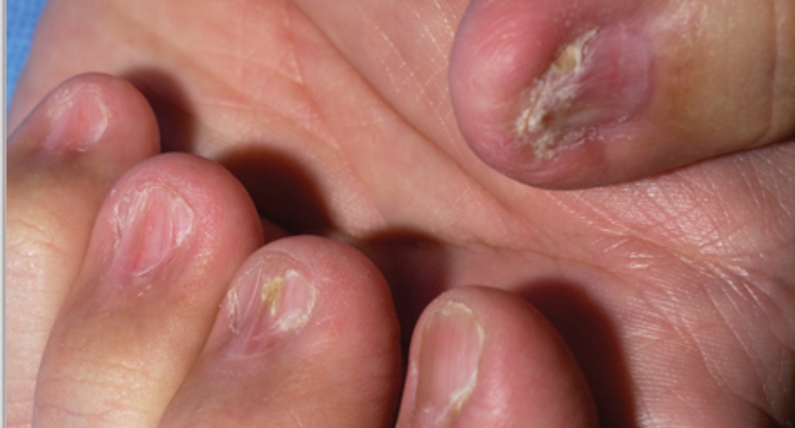
Self image
Corticosteroid side effects

Slide 48
Don't worry, it's not just you!!! Sexual function is one of the most prevalent and persistent long-term concerns after BMT.

Slide 49
What can you do to improve your sexual relationship
Believe that this situation is fleeting
Ask your gynecologist for hormone therapy, at least in the vulva and vagina - it will improve lubrication and make your intercourse less painful
Discuss your difficulties with your partner
Use lubricants or extra-lubricated condoms
Keep the intimacy of affection and contacts – not necessarily with penetrative sex.

Slide 50
Fertility planning preservation
Gynecological care over time
Ovarian reserve assessment
Early sign guidance
Search for early signs
Active search for genital GVHD
Early treatment
GVHD /exams
Cervical cancer screening
STI screening
If complaints
GVHD Assessment
HPV vaccination
at > 6 m
Screening :
Cervcial câncer >21 Years
Breast câncer > 40 Years
Osteoporois / CVD Hypothyroidism
Menorrhagia
treatment
avoid hormone treatment
Cyclic hormone therapy
Hormonalttreatment
Menses management suppession
Menses suppression
When thrombocytopenia
Contraception
Avoid sexual intercourse
With condom use
Guidance IST and early detection GVHD
Sexual
Hralth
BEFORE
During impacient stay
< 100 days
> 100 days
Until 2 years
Long term
Mauad and Novais – JBMTCT 2021
Notes:
Figura 5. Linha do tempo de cuidados para mulheres submetidas a Transplante de Células Tronco Hematopoiéticas . DECH – Doença do Enxerto contra o Hospedeiro; TCPH – Transplante de Células Precursoras Hematopoiéticas; IST – Infecções Sexualmente Transmissíveis. HPV – Papiloma Virus Humano; DCV – Doença Cardio-Vascular. CO – Colpocitologia Oncótica. Adaptado de A Practical Guide to Gynecologic and Reproductive Health in Women Undergoing Hematopoietic Stem Cell Transplant.Jeanne Murphy CNM PhD , Mary McKenna MD ,Suzanne Abdelazim DO , Minoo Battiwalla MD ,Pamela Stratton MD
doi.org/10.1016/j.bbmt.2019.07.038

Slide 51
Management of genital GVHD needs to be focused on early recognition and specialist treatment with at least, annual gynecological examination.
Brennan A, Hickeya M. Maturitas.105( 2017) 30-32

Slide 52
Thank you for your attention lenira.cliam@gmail.com

Slide 53
Let Us Know How BMT InfoNet Can Help YOU!
Visit our website: bmtinfonet.org
Email us: help@bmtinfonet.org
Give us call: 888-597-7674
We're here to help every step of the way!

